Slide 1
An Introduction to Data Visualisation
Dr Jon Minton
Advanced Quantitative Methods Network (AQMeN)
University of Glasgow

Slide 2
To start off, how about some introductions?
Who are you?
Where are you from and what do you do?
Why are you interested in data visualisation?
What do you understand by the term ‘data visualisation’?
What do you want to achieve by the end of the day?
What do want to achieve regarding data visualisation in the longer term?

Slide 3
Cutting to the Chase: Main Arguments
Information visualisation is not data visualisation. (But data visualisation is a type of information visualisation)
Data visualisation has a grammar and comes in layers
We can’t have too much information, but we can have too much data; data visualisation (and statistics) is about making data more informative
Good data visualisations are good matches
You need to wear Three Hats (and will spend most of your time wearing a Hard Hat)

Slide 4
Approach for this workshop
INTERRUPTIONS are fine
Talking heavy first half
Practical heavy second half
Approach to the practicals:
Organic: if it’s useful and there’s time, keep going
Frequent feedback: check in with the group every 5-10 minutes
Learning as teaching; teaching as learning

Slide 5

(Mis)information is Beautiful
Tim Harford
Economist
Presenter of Radio 4’s More or Less
Argues we should beware of data visualisation
Data visualisation dazzles, rather than informs
http://view6.workcast.net/?pak=8615439470431294#

Slide 6
My position
I agree (mostly)
But you’re using the wrong term.
You’re talking mainly about ‘infographics’ rather than data visualisations
Infographics are NOT data visualisations
Infographics are information visualisations
Data visualisations are information visualisations
But (most) infographics are not data visualisations
So, what makes a data visualisation a data visualisation rather than some other kind of information visualisation?

Slide 7


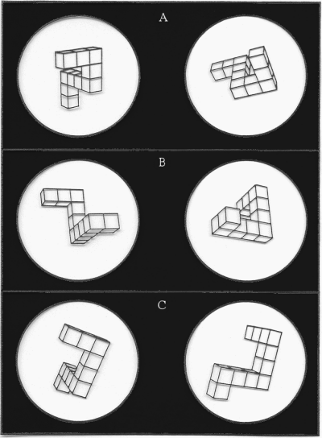

Thought is Visual
Stephen
Kosslyn
George
Lakoff

Slide 8

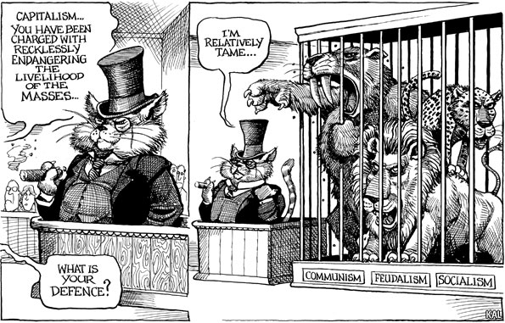
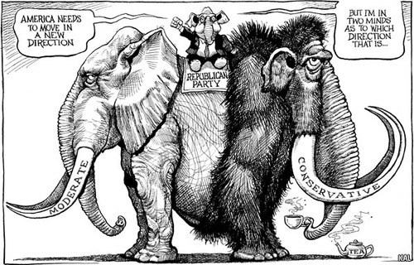
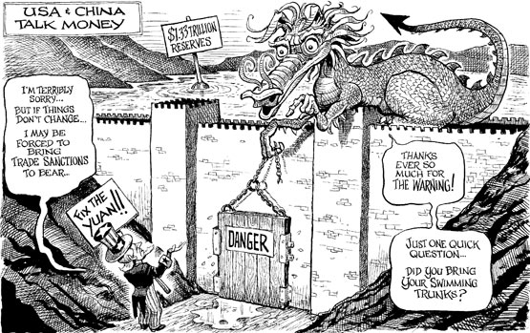
Examples

Slide 9
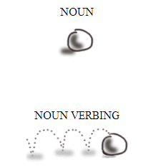
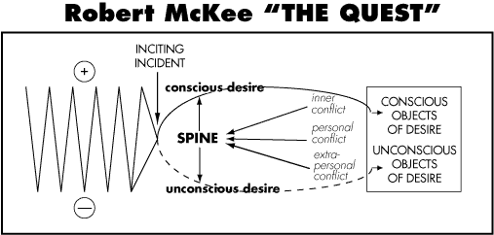
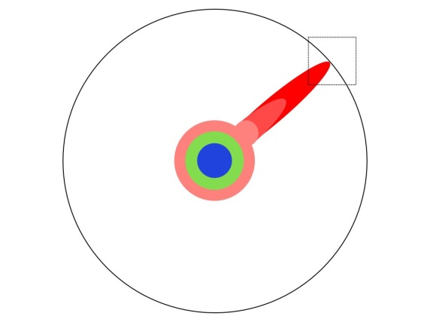
Examples

Slide 10
Time is spatial...
Then
Now

Slide 11


...but is it cultural?
Then
Now
The quick brown fox jumps over the lazy dog
Now
Then
Now
Then

Slide 12
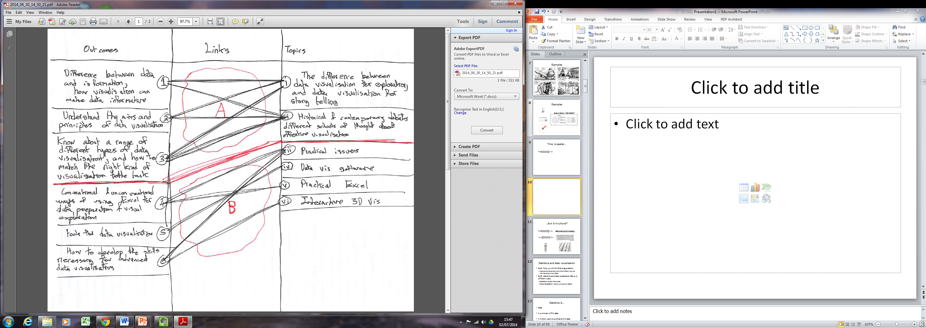
Information Visualisation of this course!

Slide 13
Statistics and data visualisation
Both help us with the following problem:
We cannot have too much information, but we can have too much data.
Both statistics and data visualisation help us in different ways:
Statistics: lowers the hurdle
Data Visualisation: allows us to jump higher

Slide 14
Statistics is...
Data
A summary of the data
A model used to summarise the data
Inferences, predictions, projections based on the model used to summarise the data

Slide 15
Statistics is...
Data
Reduction

Slide 16
Data Visualisation is…
… you tell me.
Let’s (briefly) explore the history of data visualisation

Slide 17
History of Data Visualisation
The Milestones Project
1644: First data graph (Michael Langren)
1701: First contour map (Edmond Halley)
1752: Developments in contour maps (Phillippe Buache)
1753: Annotated timelines (Jacques Barbeu-Dubourg)
1765: Annotated biographical timelines (Joseph Priestley)
1786: Bar charts, and line graphs (William Playfair)
Let’s explore Playfair’s visualisations in more detail...

Slide 18
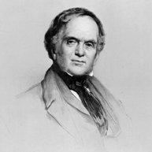
William Playfair
Born 1759
Died 1823
Architect
Mathematician
Economist

Slide 19
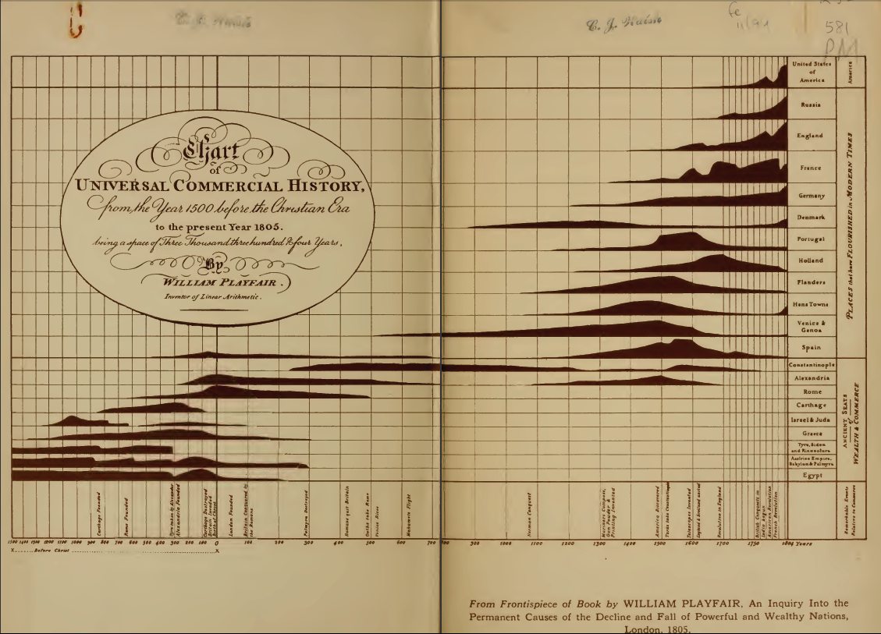
William Playfair

Slide 20
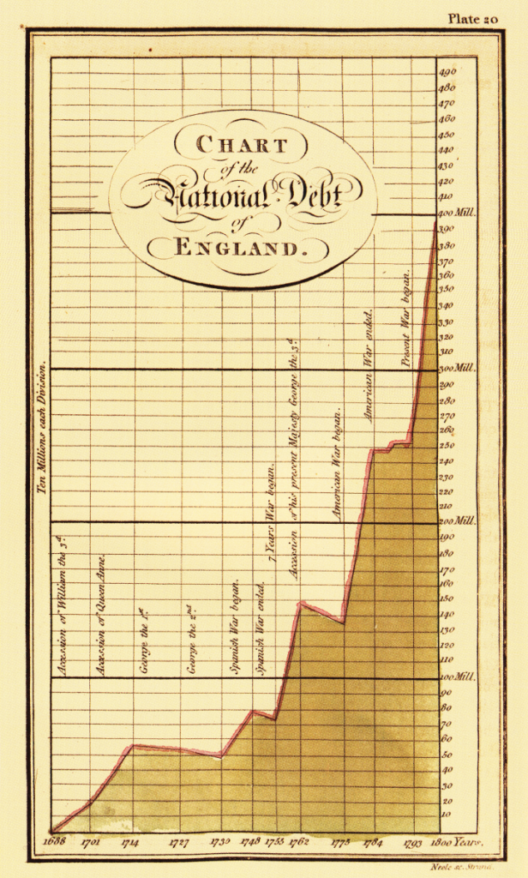
William Playfair
Note the use of
proportions
Visualisations as rhetoric

Slide 21

Charles Minard
Born 1781
Died 1870
Civil Engineer until 1851
Retired* from 1852
* This is when he produced most of his visualisations

Slide 22

Charles Minard
“...the best statistical graphic ever drawn”? – Edward Tufte

Slide 23
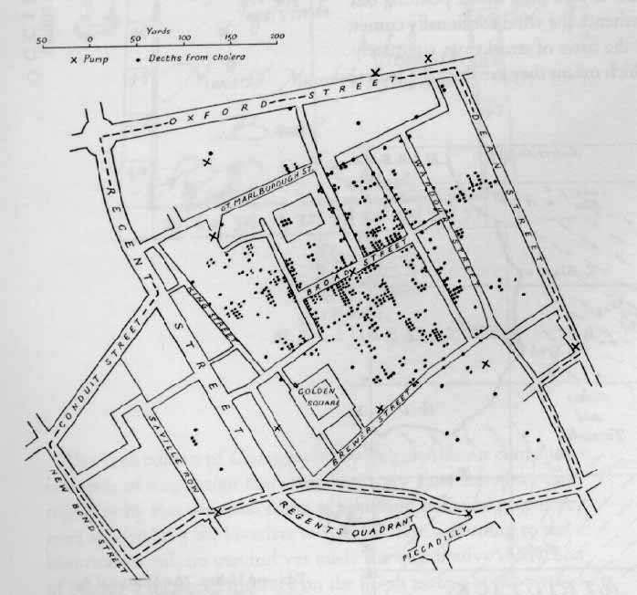
History of Data Visualisation
The Milestones Project (Continued)
1855: Dot maps to identify origin of a cholera outbreak in London (John Snow)
Dots save lives

Slide 24
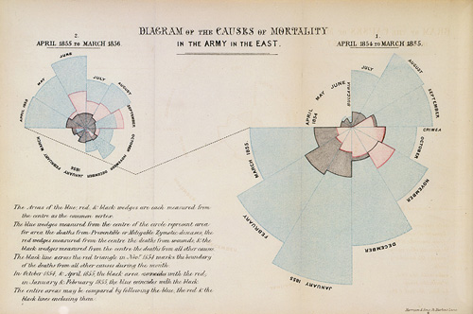
History of Data Visualisation
The Milestones Project (Continued)
1857: Polar area charts AKA coxcombs (Florence Nightingale)
Wedges save lives

Slide 25

John Tukey
Born 1915
Died 2000
Mathematician
(Electronic Engineer)
Contributions to data visualisation:
Box plots
‘Exploratory Data Analysis’

Slide 26
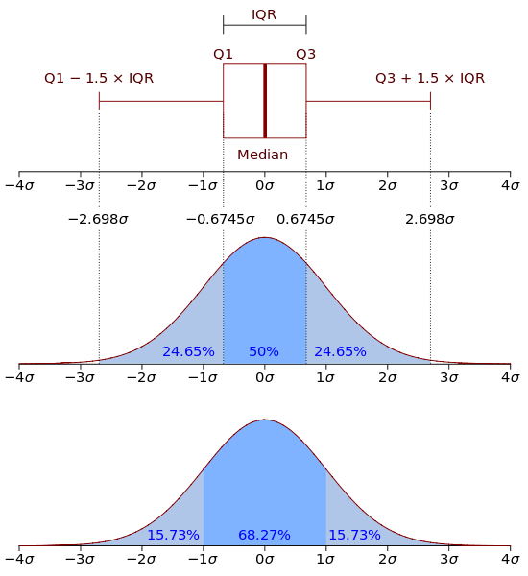
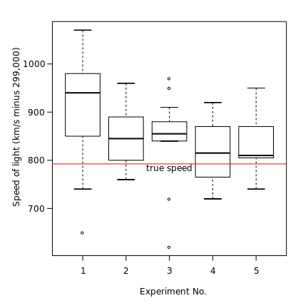
John Tukey
Box plots
Visual representation of a number of key statistics used to summarise a sample of observations

Slide 27
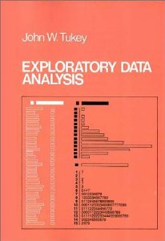
John Tukey
Exploratory Data Analysis
Crudely:
A series of (mainly visual) methods for trying to be less dependent on summary statistics and the assumptions used to construct them.

Slide 28
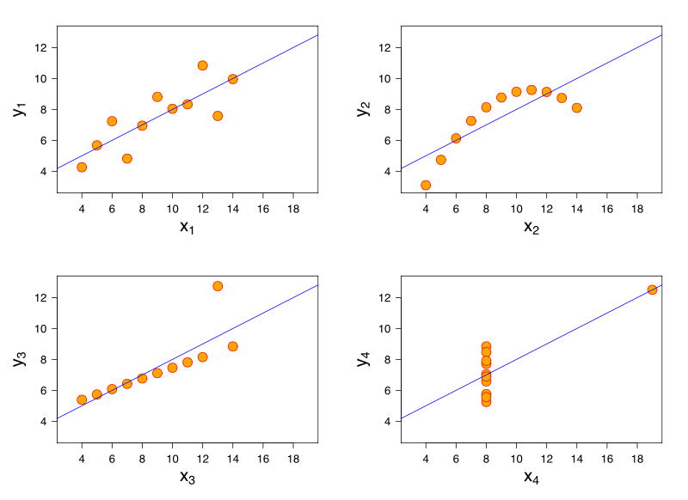
Why use visualisation for Exploratory Data Analysis?
I |  | II |  | III |  | IV
x | y | x | y | x | y | x | y
10.0 | 8.04 | 10.0 | 9.14 | 10.0 | 7.46 | 8.0 | 6.58
8.0 | 6.95 | 8.0 | 8.14 | 8.0 | 6.77 | 8.0 | 5.76
13.0 | 7.58 | 13.0 | 8.74 | 13.0 | 12.74 | 8.0 | 7.71
9.0 | 8.81 | 9.0 | 8.77 | 9.0 | 7.11 | 8.0 | 8.84
11.0 | 8.33 | 11.0 | 9.26 | 11.0 | 7.81 | 8.0 | 8.47
14.0 | 9.96 | 14.0 | 8.10 | 14.0 | 8.84 | 8.0 | 7.04
6.0 | 7.24 | 6.0 | 6.13 | 6.0 | 6.08 | 8.0 | 5.25
4.0 | 4.26 | 4.0 | 3.10 | 4.0 | 5.39 | 19.0 | 12.50
12.0 | 10.84 | 12.0 | 9.13 | 12.0 | 8.15 | 8.0 | 5.56
7.0 | 4.82 | 7.0 | 7.26 | 7.0 | 6.42 | 8.0 | 7.91
5.0 | 5.68 | 5.0 | 4.74 | 5.0 | 5.73 | 8.0 | 6.89
The Anscombe Quartet (1973)

Slide 29
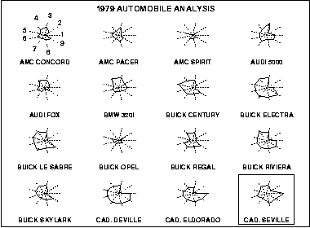
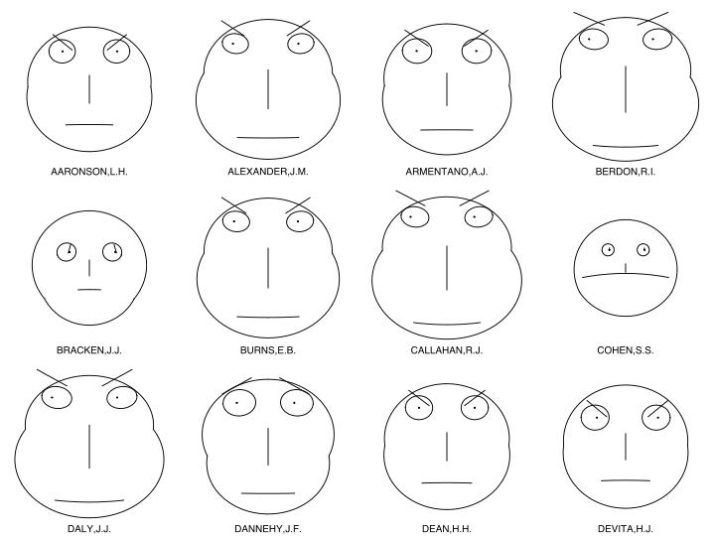
History of Data Visualisation
The Milestones Project (Continued)
1971: Irregular polygons AKA Star Plots (Friedmen & Siegel)
1973: Cartoon faces (Herman Chernoff)

Slide 30
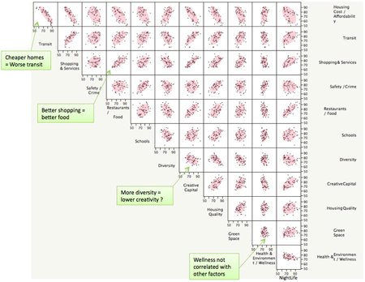
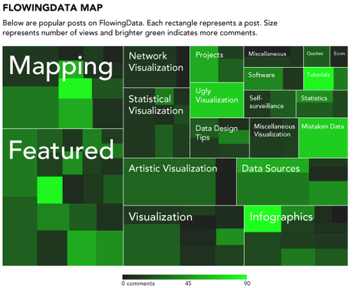
History of Data Visualisation
The Milestones Project (Continued)
1975: Scatterplot matrices – tables and graphs (John Hartigan)
1981: Mosaic plots (Hartigan & Kleiner)

Slide 31

Edward Tufte
Born 1942
Statistician
Sculptor
Advisor to Obama
Contributions to data visualisation
Conceptual Tools
Data Ink Ratios
Lie Factors
Chart Junk
Visualisations
Small multiples
Sparklines

Slide 32
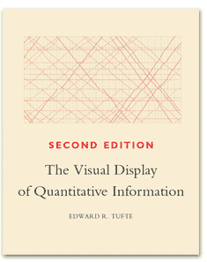
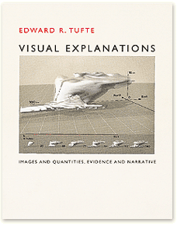
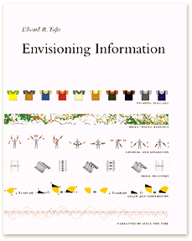

Books by Edward Tufte

Slide 33
Data Visualisation is…
The development and consistent application of rules for mapping between rules and graphics.
(A necessary condition for something to be a data visualisation; but not a sufficient condition for something to be a good data visualisation)

Slide 34
The Three Hats
Three different skill sets
Three different mind sets
What are they?

Slide 35
The Three Hats
Scientist
Artist
Engineer

Slide 36
The Engineer must have broad shoulders
S
A
E

Slide 37
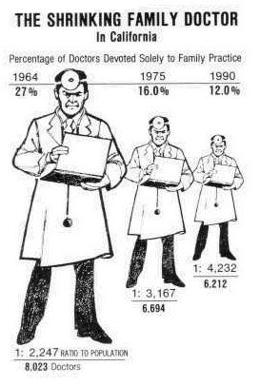
Are your visualisations... lying?
S
A
E
What’s the ‘lie factor’?
- Edward Tufte
“
The representation of numbers, as physically measured on the surface of the graphic itself, should be directly proportional to the quantities represented
”
Tufte 1991

Slide 38
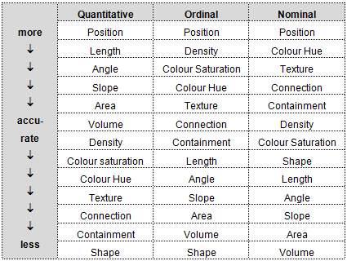
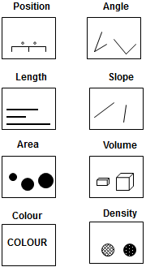
Are your visualisations... Accurately interpretable?
S
A
E
Cleveland W & McGill R (1985), ‘Graphical Perception and Graphical Methods for Analysing Scientific Data’, Science (229) 4716: 828-833

Slide 39
Are your visualisations... Sensible?
S
A
E

Slide 40
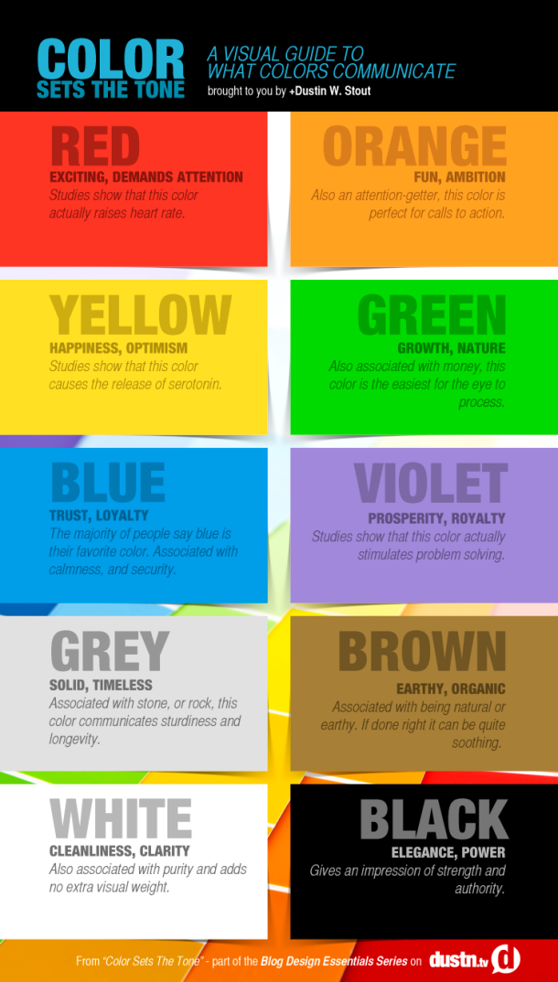
S
A
Visualisations and colour
E

Slide 41
Why is Facebook blue?
S
A
Colour and accessibility
E

Slide 42
S
A
Colour and
appropriateness to variables
E

Slide 43
Circles and Squares: A faultline?
S
A
E

Slide 44
Data Management
S
A
E
Very important
Useful things to know
Importing from plain text
Importing from web tables
Exporting
Cleaning
Formatting
Rearranging Data

Slide 45
Tidy Data
S
A
E
Database theory
Can we distinguish parts of a table into:
Keys
Something that uniquely identifies an observation
Variables
Something that we measure when we make observations
Values
The result of measuring a specific variable in a specific observation

Slide 46
Making Data ‘Tidy’
S
A
E
What are the keys, variables, and values?
Surname | First name | Month of trial | Height | Condition | Weight
Smith | Mary | 1 | 78 | Healthy | 45
Smith | John | 2 | 62 | Sick | 52
Jones | William | 1 |  | Healthy
Jones | William | 2 | 86 |  | 84
Smith | Mary | 3 | 78 | Sick | 43

Slide 47
Making Data ‘Tidy’
S
A
E
Variables
Surname | First name | Month of trial | Height | Condition | Weight
Smith | Mary | 1 | 78 | Healthy | 45
Smith | John | 2 | 62 | Sick | 52
Jones | William | 1 |  | Healthy
Jones | William | 2 | 86 |  | 84
Smith | Mary | 3 | 78 | Sick | 43
Values
Keys

Slide 48
Keys: Unique identifiers of observations
S
A
E
Surname | First name | Month of trial | Key
Smith | Mary | 1 | Smith_Mary_1
Smith | John | 2 | Smith_John_2
Jones | William | 1 | Jones_William_1
Jones | William | 2 | Jones_William_2
Smith | Mary | 3 | Smith_Mary_3

Slide 49
Keys: Unique identifiers of observations
S
A
E
Surname | First name | Month of trial | Key
Smith | Mary | 1 | Smith_Mary_1
Smith | John | 2 | Smith_John_2
Jones | William | 1 | Jones_William_1
Jones | William | 2 | Jones_William_2
Smith | Mary | 3 | Smith_Mary_3

Slide 50
Long format data
S
A
E
‘Clay’: Something that is easy to reform into many alternative structures
A good format for data storage and archiving

Slide 51
‘Casting’ Data
S
A
E
 |  | Month
 |  | 1 | 2 | 3 | 4 | 5 | 6 | 7 | 8 | 9 | 10
Person | A | 78 | 79 | 75 | 69 | 64 | 65 | 62 | 59 | 59 | 62
 | B | 56 | 59 | 62 | 61 | 55 | 58 | 63 | 67 | 69 | 62
 | C | 92 | 99 | 105 | 101 | 104 | 111 | 114 | 105 | 97 | 99
 | D | 48 | 49 | 49 | 56 | 59 | 55 | 63 | 66 | 61 | 52
 | E | 66 | 70 | 64 | 62 | 68 | 63 | 64 | 64 | 62 | 67
 | F | 99 | 98 | 87 | 88 | 86 | 85 | 86 | 82 | 79 | 85
 | G | 154 | 160 | 161 | 154 | 148 | 149 | 142 | 139 | 137 | 133

Slide 52
Adding Summary Margins
S
A
E
Person | 1 | 2 | 3 | 4 | 5 | 6 | 7 | 8 | 9 | 10
A | 100 | 101 | 96 | 88 | 82 | 83 | 79 | 76 | 76 | 79
B | 100 | 105 | 111 | 109 | 98 | 104 | 113 | 120 | 123 | 111
C | 100 | 108 | 114 | 110 | 113 | 121 | 124 | 114 | 105 | 108
D | 100 | 102 | 102 | 117 | 123 | 115 | 131 | 138 | 127 | 108
E | 100 | 106 | 97 | 94 | 103 | 95 | 97 | 97 | 94 | 102
F | 100 | 99 | 88 | 89 | 87 | 86 | 87 | 83 | 80 | 86
G | 100 | 104 | 105 | 100 | 96 | 97 | 92 | 90 | 89 | 86
Mean | 100 | 104 | 102 | 101 | 100 | 100 | 103 | 102 | 99 | 97

Slide 53
A Practical
Search online for a dataset
Guardian Data Archive
Office for National Statistics
Scottish Neighbourhood Statistics
A table reported in HTML
World Health Organisation
Take note of what it contains, how it’s formatted, and how/if it should be reformatted for better data visualisation

Slide 54
A Question
What is a good data visualisation?

Slide 55
The Answer
It depends.
Good data visualisations don’t have to be:
Quick
Simple
Easy to understand
Original
Eye-catching
What matters is how well matched the visualisation is with the audience

Slide 56
Two types of audience
Internal/Specialist
Data Visualisation as Exploratory Data Analysis
A recursive, two-way process
External/Generalist
‘Narrative’ Data Analysis
A one-way process

Slide 57
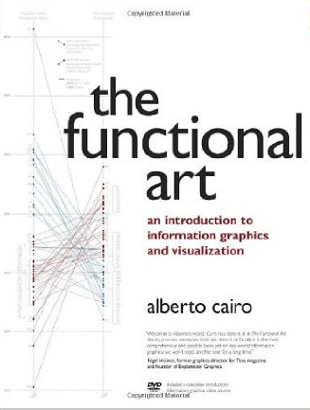
The Complexity Challenge
Unidimensional
Multidimensional
Light
Dense
Familiar
Original
Figurative
Abstract
Decorative
Functional
Redundancy
Novelty

Slide 58
Data Visualisation is...
... using quantitative (statistical) data as instructions for the production of images.
QUESTIONS
What data?
How are the data converted into instructions?
Who/what is being instructed?
What image?

Slide 59
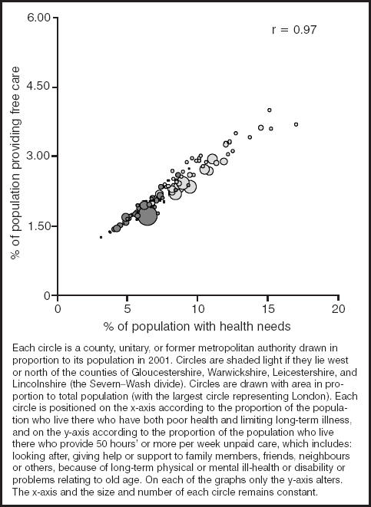
As an example...
How are data being converted into instructions here?
How many dimensions does this visualisation have?

Slide 60
As an example...
How are data being converted into instructions here?
How many dimensions does this visualisation have?
Shaw M & Dorling D (2004) “Who cares in England and Wales? The Positive Care Law: cross-sectional study” British Journal of General Practice, 54 (509): 899-903

Slide 61
Data Visualisation as Box Wiring
Data Variable |  | Graphical Aesthetic
% of population providing free care |  | Position along horizontal axis
% of population with health needs |  | Position along vertical axis
Areal unit population |  | Size of bubble
Geographical location (North or south) |  | Colour of bubble

Slide 62
Data Visualisation as Box Wiring
Data Variable |  | Graphical Aesthetic
% of population providing free care |  | Position along horizontal axis
% of population with health needs |  | Position along vertical axis
Areal unit population |  | Size of bubble
Geographical location (North or south) |  | Colour of bubble

Slide 63
Double-Encoding for Emphasis
Data Variable |  | Graphical Aesthetic
% of population providing free care |  | Position along horizontal axis
% of population with health needs |  | Position along vertical axis
Areal unit population |  | Size of bubble
Geographical location (North or south) |  | Colour of bubble

Slide 64
An Exercise
Find a data visualisation and ‘wire the boxes’
Data Variables on the left hand side
Graphical Aesthetics on the right hand side
Draw ‘wires’ connecting them
Time: 10-15 minutes?

Slide 65
Layers of Data Visualisation
The Guide Layer
Scales
Coordinate Systems
Legends
The Data Layer
Transformations
Aesthetics
Geometrics
The Annotation Layer
Everything else

Slide 66
The Guide Layer: Excel Default

Slide 67
The Guide Layer: Major Gridlines

Slide 68
The Guide Layer: Major and Minor Gridlines

Slide 69
The Guide Layer: Major and Minor Gridlines

Slide 70
The Guide Layer: Gridlines Removed

Slide 71
The Guide Layer: Unit interval tickmarks

Slide 72
The Guide Layer: 1:1 Ratio

Slide 73
The Support Layer: Excel Default

Slide 74
The Geom: Points

Slide 75
The Geom: Lines

Slide 76
The Geom: Bars

Slide 77
The Geom: Area

Slide 78
The Annotation Layer

Slide 79
The Annotation Layer

Slide 80
The Annotation Layer
Fig XXX: A plot of y against x. Y represents... X represents... Note the ...Sed consequat dolor a purus molestie aliquet. Maecenas dignissim, urna nec condimentum egestas, lectus tellus interdum enim, vel viverra felis arcu eget odio. Nam placerat faucibus sem ut ornare. Etiam et nulla quam. Suspendisse dolor diam, feugiat sit amet erat sed, accumsan hendrerit erat. Aenean dictum vulputate eros, sed adipiscing erat pulvinar a. Fusce mattis convallis metus, quis te.
Data source:...

Slide 81
The Annotation Layer
Sed at dui at urna ullamcorper cursus.
Aenean suscipit
Aenean suscipit
Aenean suscipit semper tortor eu suscipit. Vestibulum ante ipsum primis in faucibus orci luctus et ultrices posuere cubilia Curae
Data source:...

Slide 82
Practical Exercise: Decomposition
An important skill for thinking analytically about data visualisations
Find a data visualisation you like (or hate!), and write down:
The contents of each layer
The choices made in producing each layer
The data variables used
The aesthetic mappings performed
An alternative ‘recipe’ for producing a data visualisation using the same data, and what effect changing the recipe would have on the viewer’s impression of the data
Time: 20-30 minutes

Slide 83
Practical Exercise: Decomposition
Findings

Slide 84
Practical Exercise: Recomposition
An important skill for thinking analytically about data visualisations
Find a data visualisation you like (or hate!), and write down:
The contents of each layer
The choices made in producing each layer
The data variables used
The aesthetic mappings performed
An alternative ‘recipe’ for producing a data visualisation using the same data, and what effect changing the recipe would have on the viewer’s impression of the data
Time: 20-30 minutes

Slide 85
Practical Exercise: Recomposition
Findings…

Slide 86
Next Stages
Depends on you
Options:
1) An extended example of 3D visualisation of demographic data (my specialism).
2) Spending longer on producing and discussing visualisations in the workshop.
3) Talking about and sharing ‘hacks’ for getting more out of Excel (e.g. producing heatmaps, sparklines, small multiples).
4) A discussion about the training and project management implications of the Three Hats position.

Slide 87
Where next? Excel and Beyond
Payment in money
Tableau
Templates
VBA
Pivot-tables and charts
Add-ins macros
Database integration
Excel
(Basic User)
Excel
(Power User)
R
Payment in time
The Wall
You must pay to pass

Slide 88
Case Study: Three dimensional visualisation of demographic change
My specialism
Information rich visualisation
Generally for a specialist audience; not for ‘casual’ visualisation
Buy-in and willingness to invest time to learn is vital
Illustrates something about some of the engineering, scientific, and artistic challenges involved.
Notes:
A and B are the same shade of grey. Heatmaps with shade only can be misleading for this reason.

Slide 89
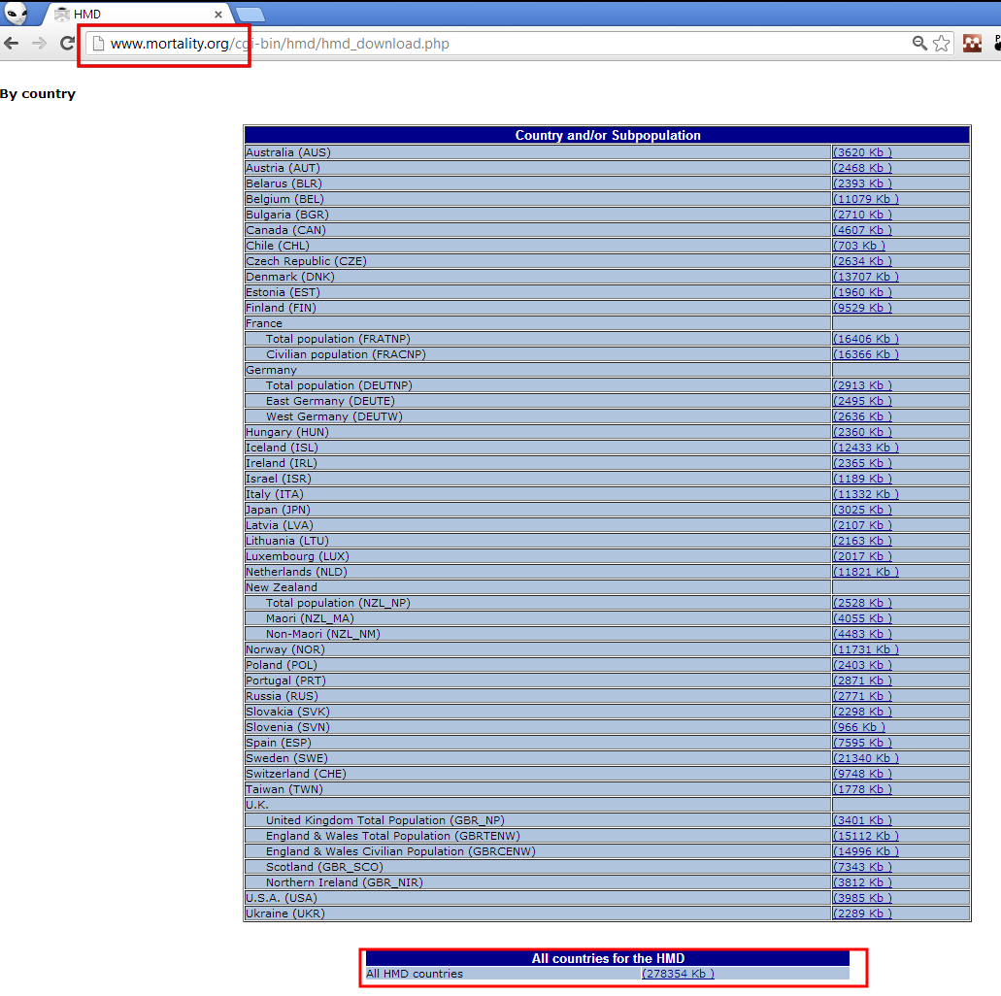
The Human Mortality Database
Notes:
This is the file I downloaded from the Human Mortality Database.

Slide 90
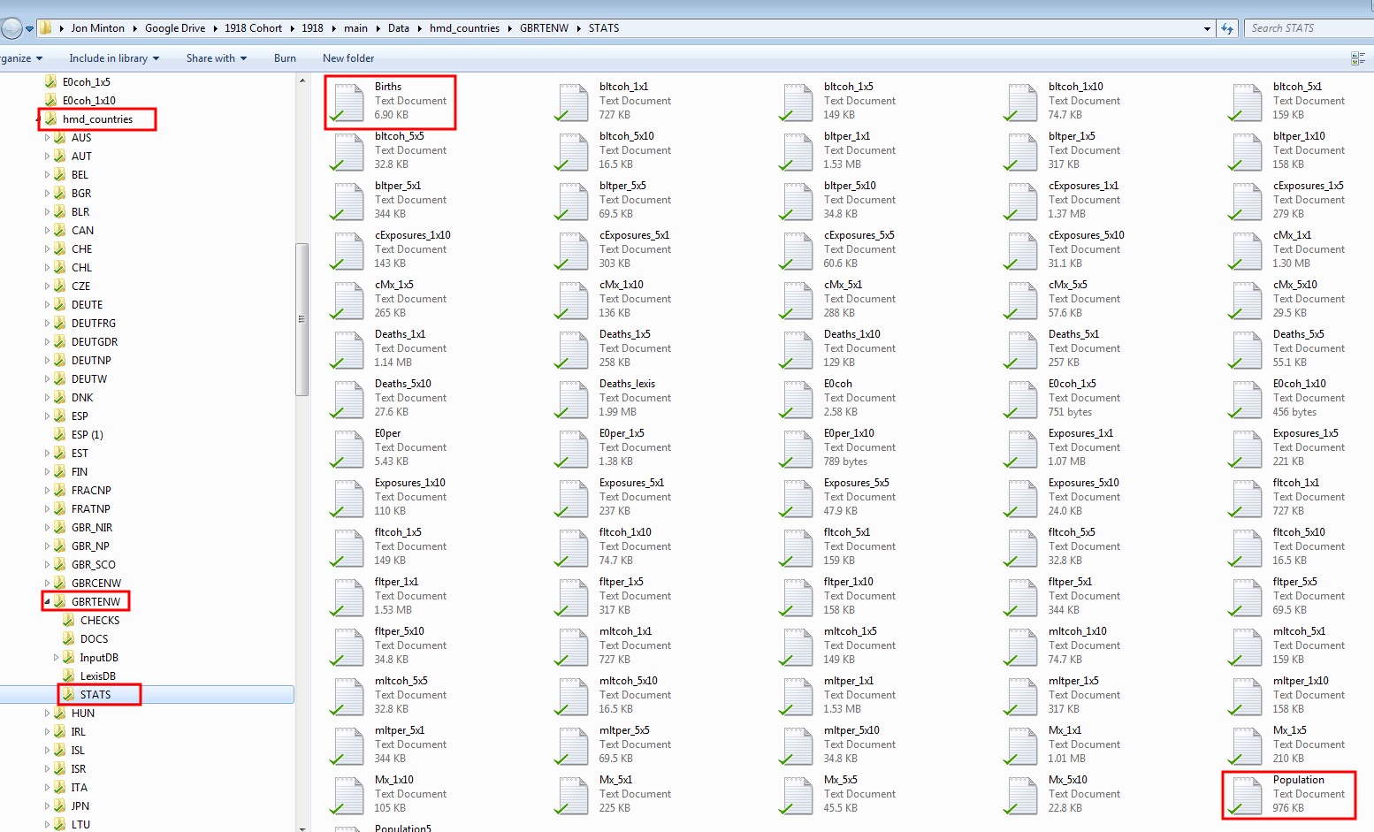
Notes:
This is an illustration of the contents and structure of the zipped file extracted, which I used for all the visualisations discussed.

Slide 91
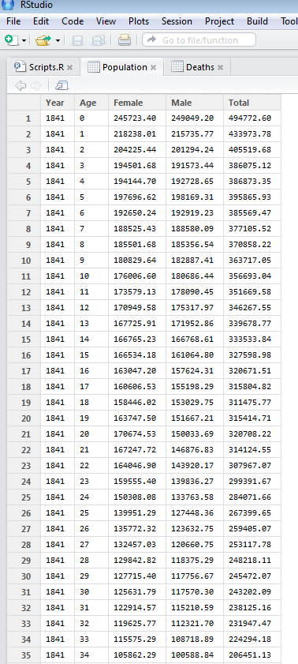
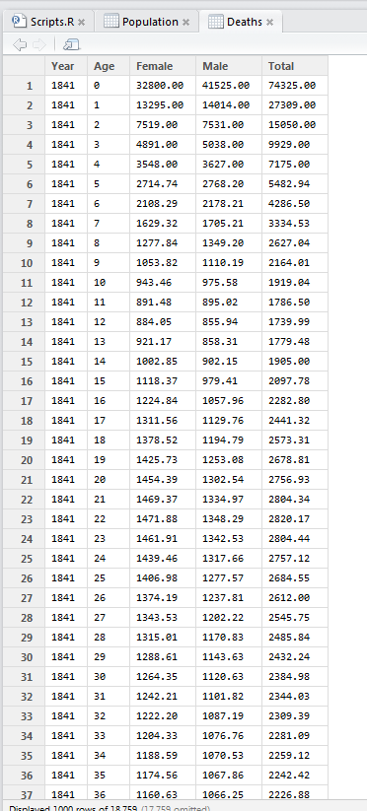
Notes:
Here are the two types of file I used from the HMD: population and deaths. The second visualisation uses both to produce crude mortality rates; the first uses deaths only.
Each country folder (shown in the previous slide) has these data for the particular country/population it contains.

Slide 92
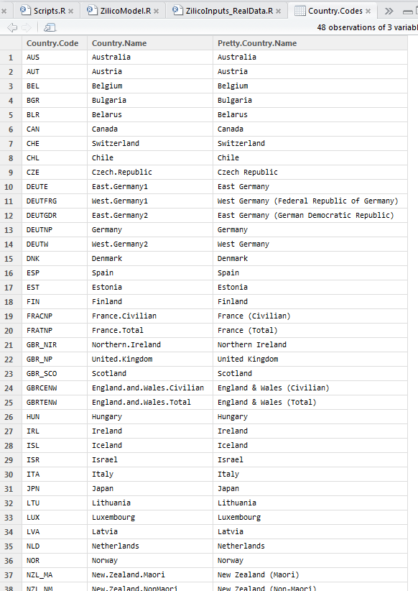
Notes:
I created a data.frame object which allowed automated loading of files and labelling/naming of outputs.

Slide 93
Automating Plotting
for (i in 1:dim(Country.Codes)[1]){
for (j in 1:2){
for (k in 1:2){
# j 1=male; 2=female
# k 1=inc ; 2=exc
if (j==1){
titletext.sex <- "(Males)"
filename.sex <- "M"
filepath.sex <- "males/"
}
if (j==2){
titletext.sex <- "(Females)"
filename.sex <- "F"
filepath.sex <- "females/"
}
if(k==1){
titletext.incexc <- "including"
filename.incexc <- "inc"
filepath.incexc <- "inc/"
}
if(k==2){
titletext.incexc <- "excluding"
filename.incexc <- "exc"
filepath.incexc <- "exc/"
}
filename.country <-Country.Codes[i, "Country.Code"]
titletext.country <- Country.Codes[i, "Pretty.Country.Name"]
filename <- paste(
"meanVarPlots/",
filepath.sex,
filepath.incexc,
filename.sex, "_",
filename.incexc, "_",
filename.country,
".tif", sep=""
)
tiff(file=filename, height=800, width=1200)
par(mar=c(5,4,4,5)+0.1)
titletext <- paste(
titletext.country,
": mean and variance in ages of death ",
titletext.sex, " ",
titletext.incexc,
" children",
sep=""
)
if(k==1){
dta.y1 <- Deaths.EV[[filename.country]]
dta.y2 <- Deaths.EV[[filename.country]]
}
if(k==2){
dta.y1 <- Deaths.EVexcInfants[[filename.country]]
dta.y2 <- Deaths.EVexcInfants[[filename.country]]
}
if(j==1){
names(dta.y1)[c(1,2)] <- c("year", "value")
names(dta.y2)[c(1,3)] <- c("year", "value")
}
if(j==2){
names(dta.y1)[c(1,4)] <- c("year", "value")
names(dta.y2)[c(1,5)] <- c("year", "value")
}
plot(
value ~ year, data=dta.y1,
main=titletext, type="l",
lwd=2, lty="solid",
ylim=c(0,100), xlab="Year",
ylab="Mean (Years)"
)
abline(v=c(1914,1918, 1939, 1945), lty="dashed")
par(new=TRUE)
plot(
value ~ year, data=dta.y2,
type="l", xaxt="n",
yaxt="n", xlab="",
ylab="", lty="dashed",
lwd=2,
ylim=c(100,1200)
)
axis(4)
mtext(expression(paste("Variance (Year",s^2,")")),side=4,line=3)
legend("bottomleft", cex=1.2, legend=c("Mean", "Variance"), lty=c("solid", "dashed"), lwd=c(2,2), bty="n")
dev.off()
}
}
}
Notes:
This is the code I developed to automate the plotting of the first visualisation

Slide 95
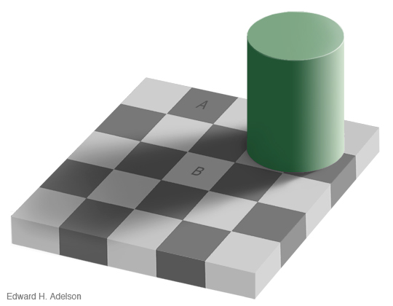
Problems with these visualisations
Pixelation/ ‘Blockiness’
Represents something that is continuous as discrete
Misinterpretation: The Checkerboard Illusion
Notes:
A and B are the same shade of grey. Heatmaps with shade only can be misleading for this reason.

Slide 102
3D Visualisation
Contour plots connect points of equal height on a surface. We can imagine but can’t see the surface itself.
How does imagination compare with (virtual) reality?

Slide 103
RGL
http://rgl.neoscientists.org/about.shtml
3D engine written in C++ but controlled by R.
Eventually wrapped it in a function which allowed calls like this:
Make3dPlot(DeathRates,country="GBR_SCO", sex=“female")
play3d(spin3d())
To produce something like this:
http://www.youtube.com/watch?v=LqJ1kWGOr7w&list=PLE_TzINC3bwC_KjA7ls4wjoUc-5QiMzyH&index=27

Slide 104
Italy

Slide 105
Italy - Logged

Slide 106
Summary
Publication in top epidemiology journal
A growing body of follow-up research avenues and publications
Invited speaker at the Oxford Institute for Ageing
A lot of time spent as an engineer:
Needed time (and sanity) invested in learning some complex specialist software.
Knotty and nasty data management challenges.
Programming challenges involved in customising and automating production of graphs.

Slide 107
Your challenge
Although I used specialist software to produce the visualisations, it’s possible to create something similar in Excel.
Even if these visualisations and data are not of particular interest to you, the challenge of producing something similar will help with learning the skills necessary to produce some of the more complex visualisations in Excel.
So, put on your hard hat and get to work…

